Slide 1
FRIDAY, FEBRUARY 12, 2016
CISM WEEK

Slide 2
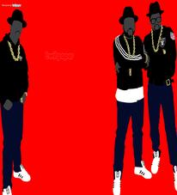
RAIDER REV 2-12-16
WHAT IS THE MOST IMPORTANT POINT YOU HAVE LEARNED IN THIS CISM LESSON?

Slide 3
TITLE” “RAP LYRICS ON TRIAL”

Slide 4
CISM FOCUS TODAY:
CONSTRUCTED RESPONSE

Slide 5
CLOSING

