Slide 1
Raider Rev
Tuesday, January 19, 2016
Grade 12
In each sentence there is a grammatical mistake. Rewrite the sentence and correct the mistake, then use context clues to define the underline word or phrase in each sentence.
My ardor was indeed the astonishment of the students and my proficiency that of the masters.
if no man allowed any pursuit whatsoever to interfere with the tranquility of his domestic affections, Greece had not been enslaved, Cesar would have spared his country, America would have been discovered more gradually, and the empires of Mexico and Peru had not been destroyed

Slide 2
Opening Session
Tuesday, January 19, 2016
Grade 12
Over the weekend, you were supposed to read Chapters 4-6.
Show that you did by completing this Raider Rev.
Follow the instructions on the sheet of paper given to you.
You have 10 minutes.

Slide 3
Opening Session
Tuesday, January 19, 2016
Grade 12
Now, turn to the inside, right page, write “Something From a Friend.”
Turn to a person either to your immediate left or to your immediate right.
Share what you have written so far with your partner.
When you are finished, write down a quote from the conversation you had with your partner. Expand on the quote you chose.

Slide 4
Opening Session
Tuesday, January 19, 2016
Grade 12
Now, turn to the inside, right page, write “Something From a Friend.”
Turn to a person either to your immediate left or to your immediate right.
Share what you have written so far with your partner.
When you are finished, write down a quote from the conversation you had with your partner. Expand on the quote you chose.

Slide 5
Opening Session
Tuesday, January 19, 2016
Grade 12
Now, turn to the back cover, and write “Something From a Classmate.”
As we discuss what you have written so far, choose something interesting from our discussion to write about in this section.

Slide 6
Work Session
Tuesday, January 19, 2016
Grade 12
Use the handout you were given to help you annotate and take notes about the novel (or any novel) as you read.

Slide 7
First Section
Tuesday, January 19, 2016
Plot
For each reading assignment, give a summary of important events.
Is there foreshadowing?
Is there suspense? Why?
Is there a major event? How will it change the plot?

Slide 8
Second Section
Tuesday, January 19, 2016
Character
Flat, Round, or Static
Personality
Relationships
Conflict
What does the character do?

Slide 9
Third Section
Tuesday, January 19, 2016
Style
Figurative Language
Irony
Imagery
Rhetorical Devices
Allusions

Slide 10
Fourth Section
Tuesday, January 19, 2016
Themes and Symbols
Are there any major themes or symbols represented in the reading section? Remember to cite evidence from the text.

Slide 11
Work Session
Tuesday, January 19, 2016
Grade 12
Please read either with a partner, or silently for the next 15 minutes.
As you read, please annotate what you read in the way that we showed you.

Slide 12

Raider Rev
Tuesday, January 19, 2016
Grade 12

Slide 13
Closing Session
Tuesday, January 19, 2016
Grade 12
Class Discussion
How does this video relate to Frankenstein?

Slide 14
Announcements
Tuesday, January 19, 2016
Grade 12
ACT/SAT Review, Credit Recovery, Frankenstein Quiz 1 Retakes after school this week Tuesday—Friday.

Slide 15
Homework
Tuesday, January 19, 2016
Grade 12
Please read through Chapter 7 tonight as homework.

Slide 16
Raider Rev
Wednesday, January 20, 2016
Grade 12
On a sheet of paper answer the following question in a three to five sentence paragraph. You have four minutes.
What do you think about when you hear the word, “Gothic?” Explain.

Slide 17
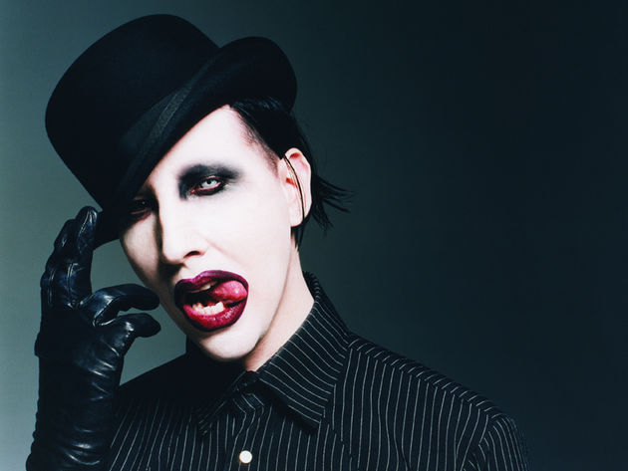

Slide 18
Essential Questions
Wednesday, January 20, 2016
Grade 12
What is Gothic literature, and what are some characteristics of the Gothic genre?

Slide 19
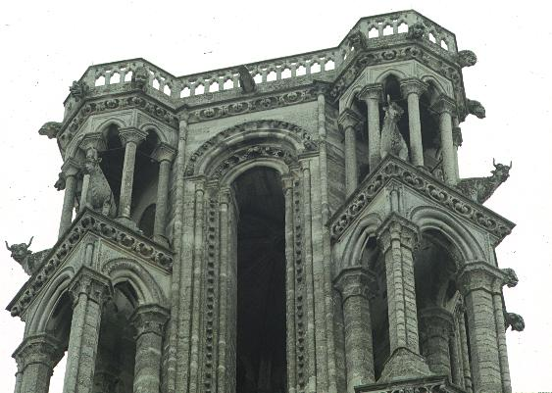
Class Discussion Wednesday, January 20, 2016
Grade 12
Look at the picture to the right and decide what, if anything, about the architecture in the photograph is Gothic.

Slide 20
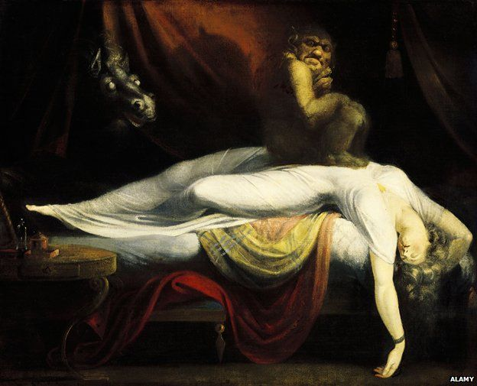
Class Discussion Wednesday, January 20, 2016
Grade 12
Look at the picture to the right and decide what, if anything, about the architecture in the photograph is Gothic.

Slide 21
Class Discussion Wednesday, January 20, 2016
Grade 12
Listen to this song from Disney’s, “The Hunchback of Notre Dame.” Decide whether there is anything Gothic in the animation.

Slide 22
Class Discussion Wednesday, January 20, 2016
Grade 12
Listen to the narration of Dracula, by Bram Stoker. Decide what, if anything, about the narration is Gothic.

Slide 23
Gothic Literature
Wednesday, January 20, 2016
Grade 12
What is a Gothic Novel?
A Gothic novel can be said to be a novel that has elements of both romanticism and horror.

Slide 24
Gothic Literature
Wednesday, January 20, 2016
Grade 12
Qualities of Gothic Literature
Supernatural Elements
Foreign and Remote Settings
“The Sublime” – a concept of beauty that places emphasis on things not typically considered beautiful
The Role of Women – “Damsels in Distress”
Mystery and Suspense

Slide 25
Gothic Literature
Wednesday, January 20, 2016
Grade 12
Gothic Literature
Frankenstein
Edgar Allan Poe
Dracula
Dr. Jekyll and Mr. Hyde

Slide 26
Work Session
Wednesday, January 20, 2016
Grade 12
How does all this relate to Frankenstein?
What are some basic questions that Frankenstein forces its readers to ask about the way the world works?
Class Discussion

Slide 27
Work Session
Wednesday, January 20, 2016
Grade 12
Choose one of the major themes or elements of Gothicism we spoke about in class.
Create a PowerPoint, Prezi, video, build a website, etc. that explores the theme you chose in detail.
Use the Internet today to search for usable sources that you can include as a part of your research. You will need at least three sources.

Slide 28
Closing Session: Pop Quiz
Wednesday, January 20, 2016
Grade 12
Answer the questions on the write in complete sentences. You do not need to write the sentence.
What two genres does the Gothic novel combine?
Name three major themes of the Gothic genre.
Name a gothic novel or literary work other than Frankenstein.
Why do you think the Gothic genre has remained in popular culture for so long?
Explain the concept of “the sublime.”

Slide 29
Announcements
Wednesday, January 20, 2016
Grade 12
ACT/SAT Review, Credit Recovery, Frankenstein Quiz 1 Retakes after school this week Tuesday—Friday.

Slide 30
Homework
Wednesday, January 20, 2016
Grade 12
Please read through Chapter 7 tonight as homework if you have not already.

Slide 31
Raider Rev
Thursday, January 21, 2016
Grade 12
What are some of the characteristics in Frankenstein that make it a Gothic novel?

Slide 32
Essential Question
Thursday, January 21, 2016
Grade 12
What is direct and indirect characterization?
What is a character foil?

Slide 33
Opening Session
Thursday, January 21, 2016
Grade 12
Complete the Incident Report from the prospective of a police officer investigating the murder of Victor’s brother, William, in Chapter 7.

Slide 34
Work Session
Thursday, January 21, 2016
Grade 12
Character
Direct Characterization:
Indirect Characterization
Physical descriptions
Names
What a character does
What other characters say

Slide 35
Work Session
Thursday, January 21, 2016
Grade 12
Character
Foils
A character foil is a character who is the opposite of another character used to draw attention to certain traits.
Can you think of a character foil for Victor Frankenstein?

Slide 36
Work Session
Thursday, January 21, 2016
Grade 12
Complete the Cell Phone Activity for one of the characters you have read about in Frankenstein, so far.
(This is when having your active reading notes would be helpful.)

Slide 37
Work Session
Thursday, January 21, 2016
Grade 12
Take a minute to find a partner who chose a different character than you did.
Share your Cell Phone Sheet with your partner and discuss what is different about each character and why that might be different.

Slide 38
Closing Session
Thursday, January 21, 2016
Grade 12
Questions?

Slide 39
Announcements
Thursday, January 21, 2016
Grade 12
There is a quiz tomorrow covering Chapters 4-7.
We will collect your active reading notes before the test.

Slide 40
Homework
Thursday, January 21, 2016
Grade 12
Read through Chapter 7 if you have not already done so.

Slide 41
Raider Rev
Friday, January 22, 2016
Grade 12
This is a single person assignment.
Is there ever a time in which you think censoring something is warranted?
Answer the question on the right with a three to five sentence paragraph
You have 4 minutes.
After you are done, staple your Raider Revs together.

Slide 42
Essential Question
Friday, January 22, 2016
Grade 12
What is the basic plot of Frankenstein?

Slide 43
Opening Session
Friday, January 22, 2016
Grade 12
To help you review for the quiz, you and up to two other people will use computer paper to create a timeline for the plot of Frankenstein.
Remember to leave enough space so that you can add to your time line later.

Slide 44
Opening Session
Friday, January 22, 2016
Grade 12
Your plot timeline should include:
All major plot points
It should include an illustration or each major plot point
It should be neat and attractive
Remember to leave room to add more to your timeline later.

Slide 45
Daily Agenda
Friday, January 22, 2016
Grade 12
Students will demonstrate their understanding of Frankenstein by creating a timeline.
Students will demonstrate their understanding of Frankenstein by taking a quiz covering Chapters 4-7
Students will widen their understanding of literary history by researching literary periods.
Opening Session
Work Session
Closing Session

Slide 46
Work Session
Friday, January 22, 2016
Grade 12
Please clear off your desk of anything except a sheet of paper and a writing utensil.
When you are finished with your test, please turn it in to Mr. Hatch and read the directions for the next assignment.

Slide 47
Closing Session
Friday, January 22, 2016
Grade 12
Choose three of the literary periods listed on the slip and use a computer to research those periods.
Major authors and/or works
Time Period during which the literary period took place
A brief summary of the major themes and focuses of the literary period.

Slide 48
Closing Session
Friday, January 22, 2016
Grade 12
Choose three of the literary periods listed on the slip and use a computer to research those periods.
Romantic Period
1800-1870
The Romantic Era was an artistic movement that swept through most of Europe. Its intention was to revolt against the established order.
Imagination versus Reason
Emotions versus Logic
Darkness versus Light
Character Stereotypes
The “Sublime” and the Exotic
Nature
William Wordsworth “I Wandered Lonely As a Cloud”
Samuel Taylor Coleridge “The Rhyme of the Ancient Mariner”
Mary W. Shelley “Frankenstein”

Slide 49
Closing Session
Friday, January 22, 2016
Grade 12
Choose three of the literary periods listed on the slip and use a computer to research those periods.
Renaissance Literature
Romanticism
Restoration Period
Neoclassical Period
Transcendental Period
Victorian Period
Realism
Modernism
Post-Modernism

