Slide 1
Raider Rev
Tuesday, February 23, 2016
Grade 12
Think of some of the monuments in our country. Why where they built? What do they symbolize?
Now imagine those same monuments 500 years in the future. How will they be perceived by future generations?

Slide 2
Essential Question(s)
Tuesday, February 23, 2016
Grade 12
How does the way in which an author structures a text, like a poem, contribute to the meaning of the poem as well as its impact?

Slide 3
Georgia English Standards
Tuesday, February 23, 2016
Grade 12
Analyze how an author’s choices concerning how to structure specific parts of a text (e.g., the choice of where to begin or end a story, the choice to provide a comedic or tragic resolution) contribute to its overall structure and meaning as well as its aesthetic impact.
ELAGSL5:

Slide 4
Daily Agenda
Tuesday, February 23, 2016
Grade 12
Opening Session
Students will compare a similar poem from the time period and decide how each poet varies the structure of the poem.
Work Session
Closing Session
Students will create a comic book representation of Shelley’s poem as and evaluate relationship between the characters in the poem.
Students will read and discuss Shelley’s Ozymandias.

Slide 5
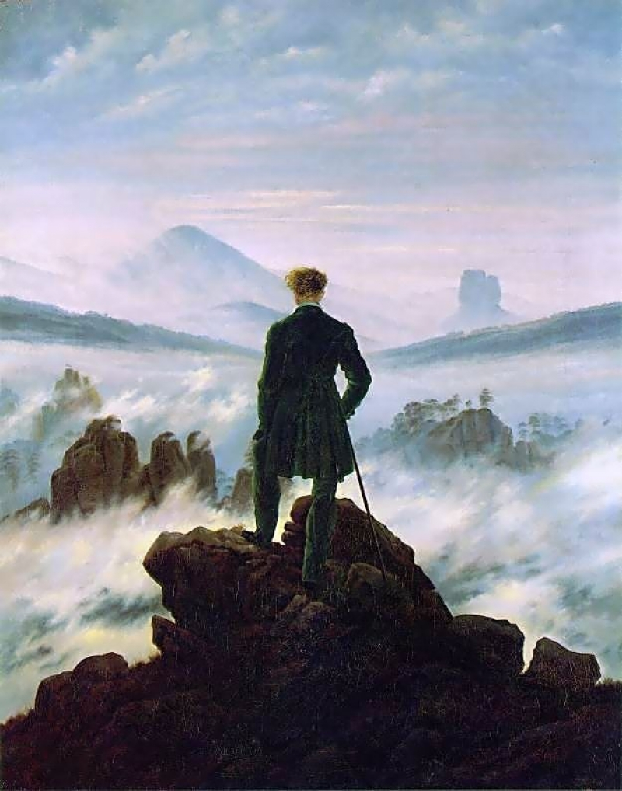
Romanticism
Tuesday, February 23, 2016
Grade 12
An artistic, literary, and intellectual movement that originated in Europe toward the end of the 18th century and in most areas was at its peak in the approximate period from 1800 to 1850. Romanticism was characterized by its emphasis on emotion and individualism as well as glorification of all the past and nature, the latter also being celebrated.

Slide 6
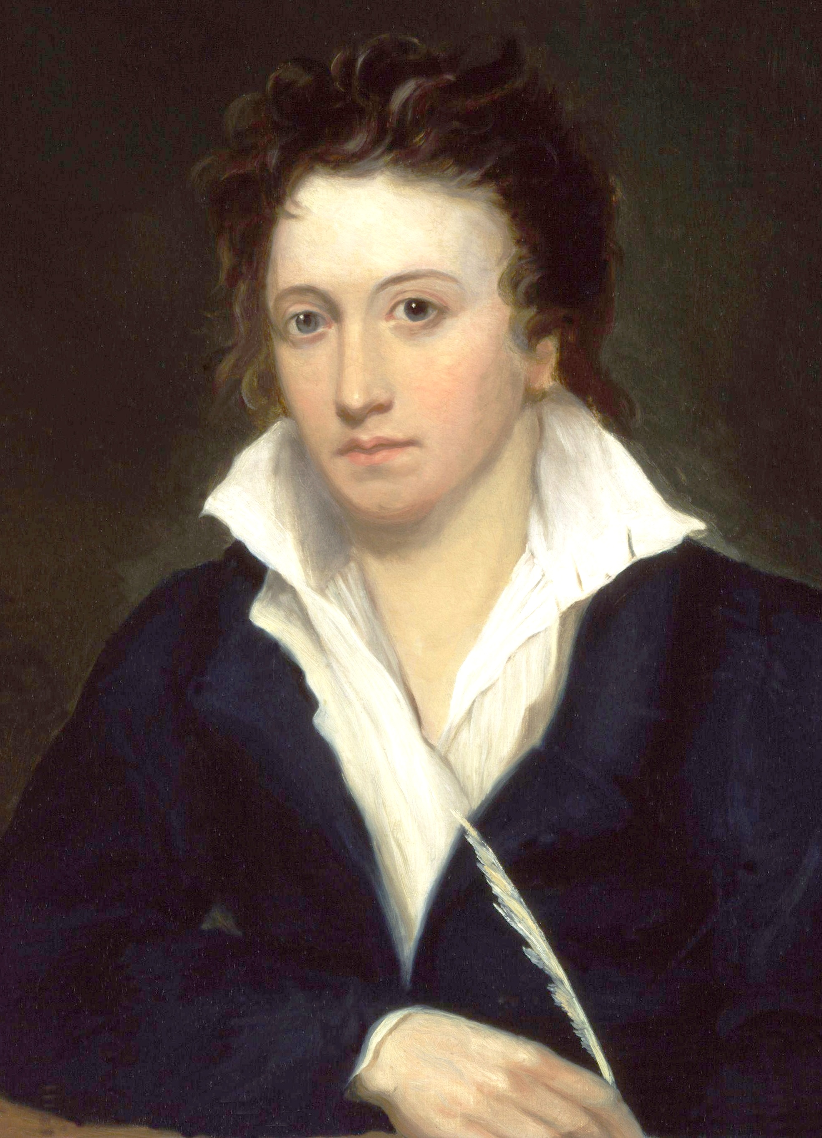
Opening Session
Tuesday, February 23, 2016
Grade 12
Percy Blythe Shelley was an English Romantic poet and husband to Mary Shelley.
Wrote “Ozymandius” and “Ode to a West Wind.”
Close friends with Lord Byron and married to Mary Shelley.

Slide 7
Opening Session
Tuesday, February 23, 2016
Grade 12
Read the poem, Ozymandias, by Percy Blythe Shelley.
After you finish, answer the questions on the next slide with the person sitting next to you.

Slide 8
Opening Session
Tuesday, February 23, 2016
Grade 12
Although “Ozymandias” begins with an “I,” it is actually an account from another speaker entirely. What effect does a framing device like this have on your reading of the poem?
What is the relationship between Ozymandias and the sculptor who immortalizes him? What specific words does Shelley use to portray their bond?
Based on “Ozymandias,” what do you think Shelley thought about the relationship between artist and patron? Between artist and creation?
Why might Shelley have used another character to describe the monument instead of using the speaker of the poem to address the reader?

Slide 9
Work Session
Tuesday, February 23, 2016
Grade 12
Depict the events described in the poem in chronological order.
Beside each of the pictures, write the text shown in the picture.

Slide 10
Work Session
Tuesday, February 23, 2016
Grade 12
What is the relationship between the five characters in the poem?
How does their relationship contribute to the overall message of the poem?
How would removing one character from the poem change the poem?
What is the structure of the poem?

Slide 11
IN Egypt's sandy silence, all alone,
Stands a gigantic Leg, which far off throws
The only shadow that the Desart knows:—
"I am great OZYMANDIAS," saith the stone,
"The King of Kings; this mighty City shows
"The wonders of my hand."— The City's gone,—
Nought but the Leg remaining to disclose
The site of this forgotten Babylon.
We wonder,—and some Hunter may express
Wonder like ours, when thro' the wilderness
Where London stood, holding the Wolf in chace,
He meets some fragment huge, and stops to guess
What powerful but unrecorded race
Once dwelt in that annihilated place.
-- Horace Smith (1779-1849)
Ozymandias

Slide 12
Closing Session
Tuesday, February 23, 2016
Grade 12
Why do you think Shelley’s Ozymandias is included in our textbook and Smith’s is not?

Slide 13
Read this poem.
Compare this poem with the Ozymandius poem we read yesterday.
How are the structures of the two poems different?
IN Egypt's sandy silence, all alone,
Stands a gigantic Leg, which far off throws
The only shadow that the Desart knows:—
"I am great OZYMANDIAS," saith the stone,
"The King of Kings; this mighty City shows
"The wonders of my hand."— The City's gone,—
Nought but the Leg remaining to disclose
The site of this forgotten Babylon.
We wonder,—and some Hunter may express
Wonder like ours, when thro' the wilderness
Where London stood, holding the Wolf in chace,
He meets some fragment huge, and stops to guess
What powerful but unrecorded race
Once dwelt in that annihilated place.
-- Horace Smith (1779-1849)
Ozymandias

Slide 14
Raider Rev
Wednesday, February 24, 2016
Grade 12
Answer these questions on the front cover of your booklet.
Why do you think Shelley’s Ozymandias is included in our textbook and Smith’s is not?
How does the way Smith’s Ozymandias change the meaning of the poem.
(Hint: First, decide the meaning of Smith’s poem)

Slide 15
Georgia English Standards
Wednesday, February 24, 2016
Grade 12
Analyze how an author’s choices concerning how to structure specific parts of a text (e.g., the choice of where to begin or end a story, the choice to provide a comedic or tragic resolution) contribute to its overall structure and meaning as well as its aesthetic impact.
ELAGSL5:

Slide 16
Daily Agenda
Wednesday, February 24, 2016
Grade 12
Opening Session
Work Session
Students will read two poems by Lord Byron, “She Walks in Beauty of the Night,” and “We will Go No More a Roving.”
Closing Session
Students will explore popular culture and find examples of a Byronic Hero.
Students will assess their understanding of the lesson by answering the essential question.

Slide 17
Essential Question(s)
Wednesday, February 24, 2016
Grade 12
What is a Byronic Hero and why are they so popular in our culture?

Slide 18
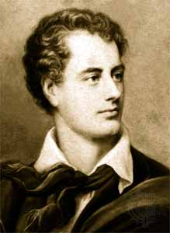
Lord Byron
Wednesday, February 24, 2016
Grade 12
Write your notes on Lord Byron on the inside of your booklet.
George Gordon Byron
Romantic English poet
Went to fight in the Greek Civil War
Died before he saw any actual fighting

Slide 19
Byronic Hero
Wednesday, February 24, 2016
Grade 12
On your paper create a Venn Diagram.
Label one side, “Hero” and the other side, “Villain.”
Label the middle, “Byronic Hero.”
With a partner, fill in the “Hero” and “Villain” sections with words that describes those two types of characters.

Slide 20
Byronic Hero
Wednesday, February 24, 2016
Grade 12
The Byronic hero is an idealized, but flawed character.
Has great talent
Dislikes society
No respect for authority or rank
Unable to love
Has a secret or troubled past
Rebellious or exiled
Arrogant or overconfidence
Self-destructive

Slide 21
Byronic Hero
Wednesday, February 24, 2016
Grade 12
Byronic heroes are called that because Byron invented characters like this and lived his life in the same way.

Slide 22
Opening Session
Wednesday, February 24, 2016
Grade 12
We will read two poems from Lord Byron, “She Walks in Beauty of the Night” and “We Will Go No More a Roving .“
What phrases or words do you hear in the poem that identifies it as “Romantic?”

Slide 23
Work Session
Wednesday, February 24, 2016
Grade 12
Refer to the “Byronic Hero Assignment Sheet” for your assignment.
Use time in class today to begin brainstorming about your project. Specifically find examples of Byronic heroes from movies, T.V. shows, and comic books.
Find at least two examples of Byronic heroes in popular culture. List them in your booklet, and for each, describe what makes them a Byronic hero.

Slide 24
Closing Session
Wednesday, February 24, 2016
Grade 12
Essential Question
What is a Byronic Hero and why are they so popular in our culture?
On the back cover of your booklet, write the essential question and answer it in a five to seven sentence paragraph.

Slide 25
Raider Rev: Journaling
Thursday, February 25, 2016
Grade 12
Have you ever been so happy that you wished you could push “pause” and stop the moment?
Describe that moment like it’s a snapshot, using imagery and figurative language.
Answer the following question in a three to five sentence paragraph.

Slide 26
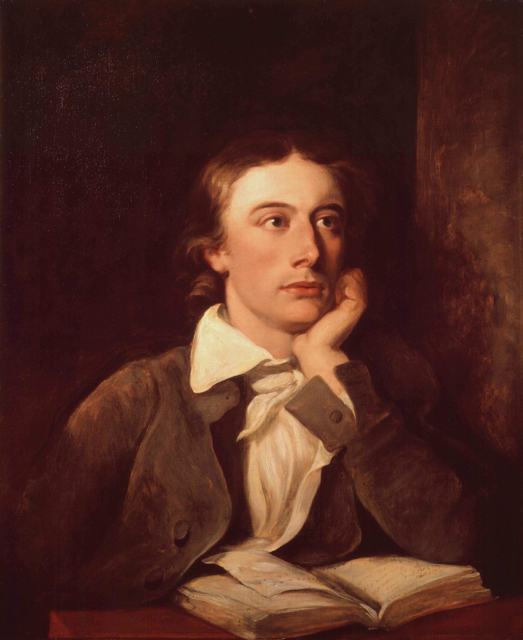
Opening Session
Thursday, February 25, 2016
Grade 12
John Keats was a poor, English medical student.
Became a poet.
Wrote “Ode to a Grecian Urn” while seeing a Grecian urn at a museum.
He died early in life.
Poems are characterized by imagery and emphasize ordinary life.

Slide 27
Opening Session
Thursday, February 25, 2016
Grade 12
Open your books to page 755 and read the poem, “Ode to a Grecian Urn” silently to yourself as it is read to you.

Slide 28
Work Session
Thursday, February 25, 2016
Grade 12
Paraphrase the stanza that was assigned to your group.
Find at least one example of figurative language (metaphor, simile, imagery, analogy, etc.) used in your stanza and explain its meaning.
Define any words you do not know in the stanza your group was assigned.

Slide 29
Opening Session
Friday, February 26, 2016
Grade 12
Each group will now read their stanza aloud to the class and tell the class what they found in their group.

Slide 30
Closing Session
Friday, February 26, 2016
Grade 12
Turn in your books to page 74

Slide 31
Work Session: Reflection
Friday, February 26, 2016
Grade 12
Go back to your journal from yesterday and reflect on how you have changed since this moment has passed.
Are you glad you have moved on from this moment?
How are is your life different now?
Do you wish you could return to this moment and do something differently?

Slide 32
Create a question poem that uses your answers to your reflection.
Include at least four questions and give your work a creative title.
The questions that you create can question the limitations of art or the intersections of truth and beauty (as does Keats’ poem), or it can address your past or future self.
Also represent your thoughts or your snapshot scene in some other artistic format. This can be done using photographs, magazine clippings, drawings, symbols, graphs, charts, etc.—as long as there is some sort of artistic element included
In one or two paragraphs, explain the connection between your journal, poem, and artistic representation. Be sure to explain how the events, images, or emotions you experienced during your memory contributed to how you remembered it.

Slide 33
Opening Session
Tuesday, March 01, 2016
Grade 12
To help you review for your quiz tomorrow over the Romantic poets, we want you to collect notes about each poet from around the room

Slide 34
Opening Session
Tuesday, March 01, 2016
Grade 12
Pair with your group.
Go to your station and collect the notes about the poet from that station.
When we ask you, move to the next station.

Slide 35
Work Session
Tuesday, March 01, 2016
Grade 12
Pair with your group.
Go to your station and collect the notes about the poet from that station.
When we ask you, move to the next station.

Slide 36
Romanticism
Tuesday, March 01, 2016
Grade 12
An artistic, literary, and intellectual movement that originated in Europe toward the end of the 18th century.
Romanticism was characterized by its emphasis on emotion the individual, and nature.
Romanticism was a direct response to Neo-Classicism

Slide 37
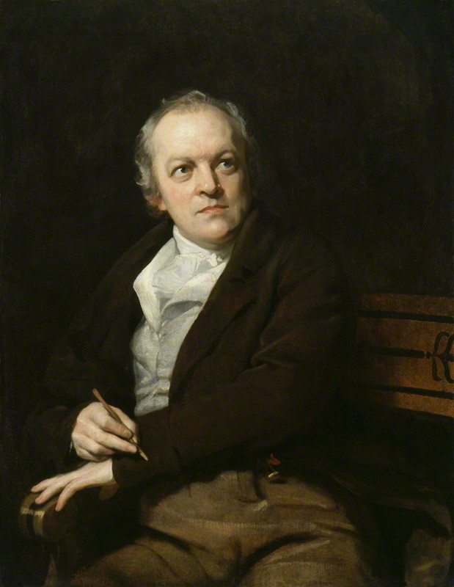
William Blake
Tuesday March 01, 2016
Grade 12
Blake was an author and print-maker
Most famous work is Songs of Innocence and Songs of Experience.
Poems were etched into lithographs and hand painted.
Famous poems include “The Lamb” and “The Tyger.”
Poems are highly critical of organized religion and of society

Slide 38
Percy Blythe Shelley
Tuesday, March 01, 2016
Grade 12
Percy Blythe Shelley was an English Romantic poet and husband to Mary Shelley.
Wrote “Ozymandius” and “Ode to a West Wind.”
Close friends with Lord Byron and married to Mary Shelley.

Slide 39
John Keats
Tuesday March 01, 2016
Grade 12
John Keats was a poor, English medical student.
Became a poet.
Wrote “Ode to a Grecian Urn” while seeing a Grecian urn at a museum.
He died early in life.
Poems are characterized by imagery and emphasize ordinary life.

Slide 40
John Keats
Tuesday March 01, 2016
Grade 12
Copy the notes at each station.
When you hear the ringer, move to the next station on the right.

Slide 41
Work Session
Tuesday, March 01, 2016
Grade 12
Which of the following lines demonstrates the emphasis on individuality during the Romantic era?
A. Than ours, a friend to man, to whom thou say'st, "Beauty is truth, truth beauty,—that is all Ye know on earth, and all ye need to know."
B. Oh! raise us up, return to us again; And give us manners, virtue, freedom, power.
C. I wandered lonely as a cloud
D. None of the above

Slide 42
Work Session
Tuesday, March 01, 2016
Grade 12
Which of the following lines demonstrates the emphasis on nature during the Romantic era?
A. What the hammer? what the chain, In what furnace was thy brain? What the anvil? what dread grasp, Dare its deadly terrors clasp!
B. She walks in beauty, like the night Of cloudless climes and starry skies;
C. Little we see in Nature that is ours; We have given our hearts away, a sordid boon!
D. Heard melodies are sweet, but those unheard Are sweeter; therefore, ye soft pipes, play on;

Slide 43
Work Session
Tuesday, March 01, 2016
Grade 12
Which of the following lines is an example of imagery?
A. My name is Ozymandias, King of Kings;
B. “Two vast and trunkless legs of stone Stand in the desert. . . .
C. Milton! thou shouldst be living at this hour: England hath need of thee:
D. He is called by thy name, For he calls himself a Lamb:

Slide 44
Work Session
Tuesday, March 01, 2016
Grade 12
Which of the following lines demonstrates a critical view of society?
A. They think they have done me no injury, And are gone to praise God and his priest and king, Who make up a heaven of our misery."
B. Though the morning was cold, Tom was happy & warm; So if all do their duty, they need not fear harm.
C. Milton! thou shouldst be living at this hour: England hath need of thee: she is a fen
D. All of the above

Slide 45
Work Session
Tuesday, March 01, 2016
Grade 12
Which of the following is NOT a trait of a Byronic hero?
A. Byronic heroes fit in with society.
B. Byronic heroes are arrogant and overconfident.
C. Byronic heroes are rebellious.
D. Byronic heroes usually have a dark secret or terrible past.

Slide 46
Opening Session
Wednesday, March 02, 2016
Grade 12
First, you will take a quiz today that will assess your knowledge of Romantic poetry and the Romantic poets.

Slide 47
After the Quiz
Wednesday, March 02, 2016
Grade 12
Metaphor
Simile
Hyperbole
Alliteration
Assonance
Synecdoche
Allusion
Imagery
Onomatopoeia
Personification
Litotes
Dialogue
Metonymy
Irony
Dialogue
Apostrophe
Idiom
Euphemism
Find the lyrics to a school appropriate song or songs you like.
You will find examples of the types of figurative language on the right in the song, write the lyric, the name of the song, and the name of figurative language on your paper.

