Slide 1
Raider Rev Monday, March 07, 2016 Grade 12
What is a dramatic monologue?

Slide 2
Raider Rev Monday, March 07, 2016 Grade 12
A dramatic monologue in literature is when a character gives a speech to another character or to an audience, like the reader.

Slide 3
Daily Agenda Monday, March 07, 2016 Grade 12
Opening Session
Work Session
Students will discuss the proper methods of writing a formal essay.
Closing Session
Students will read “My Last Duchess” and other poems by Robert and Elizabeth Browning.
Students will extend the poem by

Slide 4
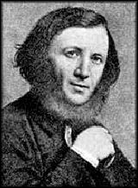
Opening Session Monday, March 07, 2016 Grade 12
Robert Browning was an English poet during the Victorian period.
Although his poetry was not very popular during his life, poems like “My Last Duchess,” have increased in popularity since his death in 1889.
Most of his poems are in the style of a dramatic monologue.

Slide 5
Opening Session Monday, March 07, 2016 Grade 12
The Victorian Era was marked by peace and prosperity within England and lasted from 1837-1901.
Advancements in literature, science, and art flourished during the period, influenced by strict moral codes.
Politically, England became more liberal and modernized, but the period also faced challenges from a starving Ireland.
Birth rates climbed, and the average lifespan throughout England and Wales increased.

Slide 6
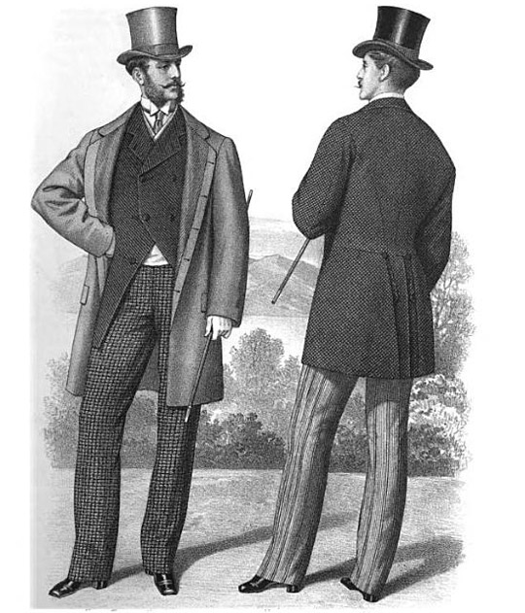
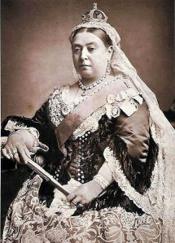
Literally think of the most British thing that you can…that’s the Victorian Era.

Slide 7
Work Session Monday, March 07, 2016 Grade 12
Read “The Last Duchess” by Robert Browning on page 837 in your textbook.
As you read, consider what kind of the person is the speaker.
How does he feel about his late wife, the last Duchess?
What does the Duke indirectly suggest about his own nature?

Slide 8
Work Session Monday, March 07, 2016 Grade 12
Prior to your disappearance, you wrote a letter to a friend, telling about your life with the Duke. Describe some of your experiences both in the early years of your marriage and throughout the painting of your commissioned portrait.
How do you view life, and what do you think of the people around you, including your husband, the Duke? What sorts of things delighted you?
Write a scene between the Duke and Duchess or the Duchess and another character of your choosing demonstrating what her life married to the Duke was like.

Slide 9
Work Session Monday, March 07, 2016 Grade 12
You are Brother Pandolf, who painted the portrait of the Duchess. You keep a journal where you write down your thoughts about all of your paintings, and the experiences that shaped their creation. You have finally decided to write down your feelings about the Duchess and her husband, the Duke Ferrara.
Based on your knowledge of the events, describe the Duchess, the Duke, and their relationship. Your assessment should be based on facts, rather than speculation.
In your group write a scene between the painter and the Duchess or Duke.

Slide 10
Work Session Monday, March 07, 2016 Grade 12
You are the envoy of a Count, who has sent you to Duke Ferrara to negotiate a wedding between the Duke and the Count's daughter. Prior to dining with the Duke's other guests, he pulled a curtain aside and revealed to you the portrait of his last Duchess, whom he described to you.
In your group, write a scene in which the envoy has a conversation with the Duke or the Count.
Based on your knowledge of the Duke through his own words, what kind of life can the Count's daughter expect as the new Duchess? Do you recommend that she marry the Duke? Why or why not? Use the Duke's own words to prepare your argument to the Count.

Slide 11
Closing Session Monday, March 07, 2016 Grade 12
Prepare to present your scenes to the class.

Slide 12
Raider Rev Tuesday, March 08, 2016 Grade 12
Get with your group from yesterday, and make sure that your scene is ready to be performed.

Slide 13
Daily Agenda Tuesday, March 08, 2016 Grade 12
Opening Session:
Students will prepare their scenes to present to the class.
Work Session:
Students will present their “My Last Duchess” scenes to the class.
Closing Session:
Students will read “Life in Love,” “Love Among the Ruins,” and “Sonnet 43.”

Slide 14
Work Session Tuesday, March 08, 2016 Grade 12
Each group will present their scene to the class.

Slide 15
Work Session Tuesday, March 08, 2016 Grade 12
Turn in your book to page 838.

