Slide 1
MONDAY, FEBRUARY 8, 2016
CISM WEEK

Slide 2
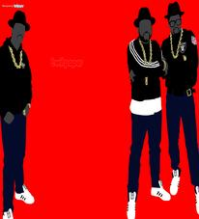
RAIDER REV 2-8-16
WHO IS YOUR FAVORITE RAPPER AND WHY???

Slide 3
TITLE” “RAP LYRICS ON TRIAL”

Slide 4
CLOSING

