Slide 1
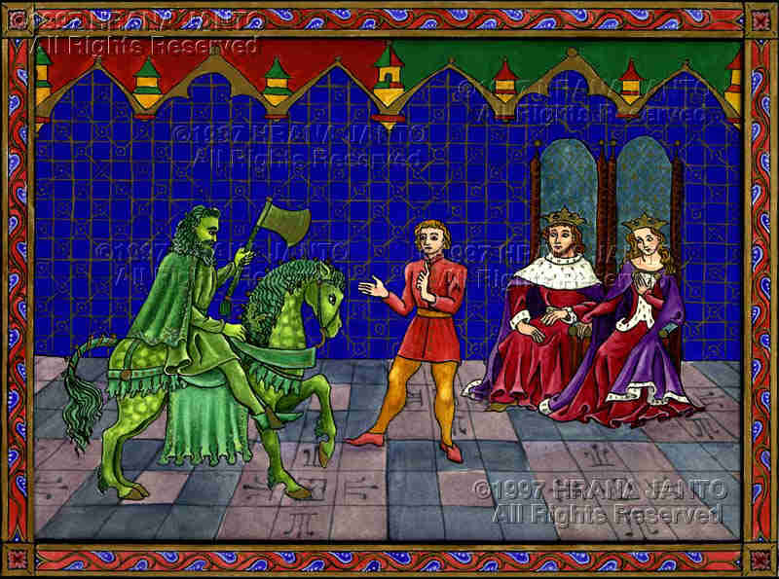
Who is this Green Knight that challenges Sir Gawain?
At King Arthur's castle, you must keep in mind that no one knows what is going on. Like Grendel, the Green Knight is a sort of creature never seen before by men.

Slide 2
A typical romance
In romances, the laws of nature are suspended, allowing mysticism or the supernatural where heroes fight the forces of evil

Slide 3
The Chivalric Hero
Sir Gawain is marked by absolute courtliness.
He is always courageous, honorable (he keeps his word), devout, loyal, and gracious toward all men and (especially) women.
Chivalry: code of conduct developed by nobles and knights

Slide 4
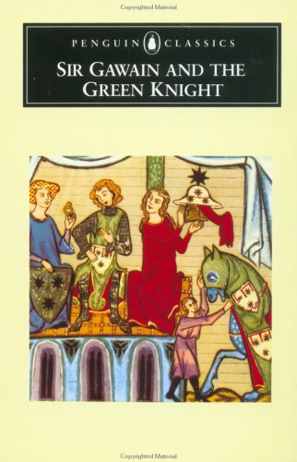
His Test
He thinks it is his courage that is being tested. He does not realize that he is enduring another kind of test.
When he arrives to face his test at the end, he finds that he has already been tested--that his test is, in fact, over.

Slide 5
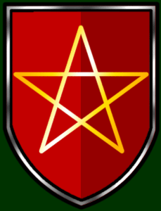
As you read, ask yourself:
What is really being tested? (This is not a simple question.)
How does Sir Gawain do?
What are we supposed to think of the Green Knight? the wife? King Arthur? his court? Sir Gawain himself?

Slide 6
Test Motif
An applicant has to pass a test to prove himself worthy. Sinners often had to suffer through painful tests (ordeals) as penance (punishment) for their sins
In this poem, Gawain is a chivalrous, heroic knight who is being tested for his courage, fidelity and sexual morality as he embarks on a quest

Slide 7
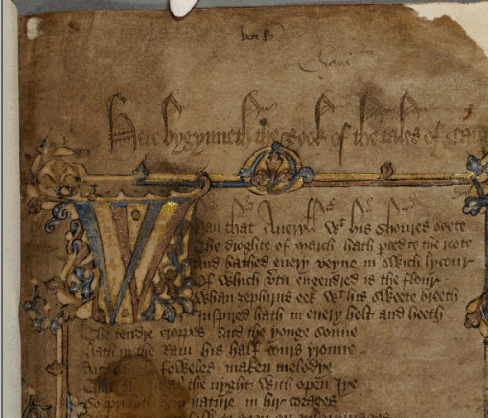
The Author
Composed this poem in the late 14th century. The poet is unknown, but he is referred to as "the Pearl poet" since he also wrote "The Pearl."
He was probably a member of a court since he is so familiar with court life, costumes, and entertainment.
The poet was a contemporary of Chaucer, and he wrote in a dialect much less modern than that of Chaucer.

Slide 8
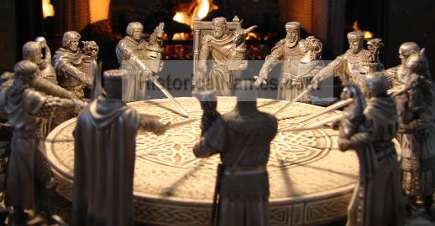
Words to know:
Feudalism: social order in medieval Europe, loyalty to the lords
Chivalry: code of conduct developed by nobles/knights

Slide 9
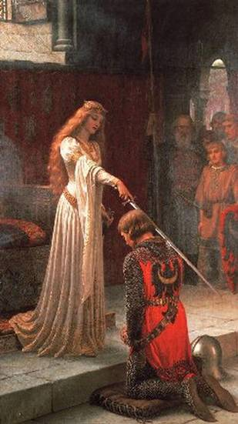
setting (time): The mythical past of King Arthur’s court (sometime after Rome’s fall, but before recorded history)
place: Camelot; the wilderness; a castle; the Green Chapel
major conflict: Gawain’s struggle over whether his knightly virtues are more important than his life. Man vs. what?

Slide 10
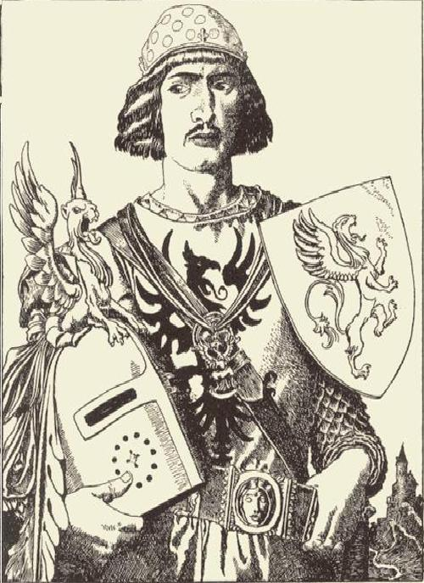
Narrator/point of view: Third person omniscient
type of work: Alliterative poem
Genre: Romance, Arthurian legend
Language: Middle English (translated into modern English)
time and place written: Ca. 1340-1400, West Midlands, England

Slide 11
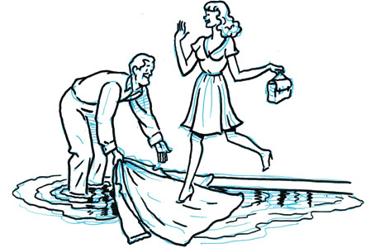
Characteristics of the medieval romance include
Stories that are full of adventure, conveying a sense of the supernatural, giving a glamorous portrayal of castle life, and chivalric ideas of bravery, honor, courtesy, fairness to enemies and respect for women
As you read, determine HOW Gawain displays ideals of chivalry

Slide 12
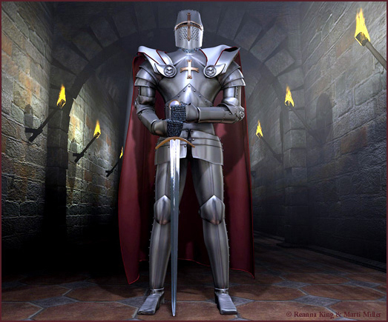
The Court and its Knights
Like the culture itself, Arthur is young and inexperienced. The knights are equally clueless.
Since everyone is starting from scratch, the knights typically go out on adventures and face the forces of good and evil, uncertain how to balance bravery and Christianity.

Slide 13
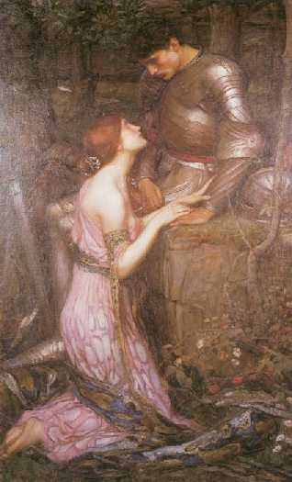
A Christian knight must decide how best to act in ambiguous situations.
Most important for the development and instruction of society, the knight must return to the court and report his actions.
Only in this way can the court learn from the individuals' experiences. Then, future knights will have more to guide them.

Slide 14
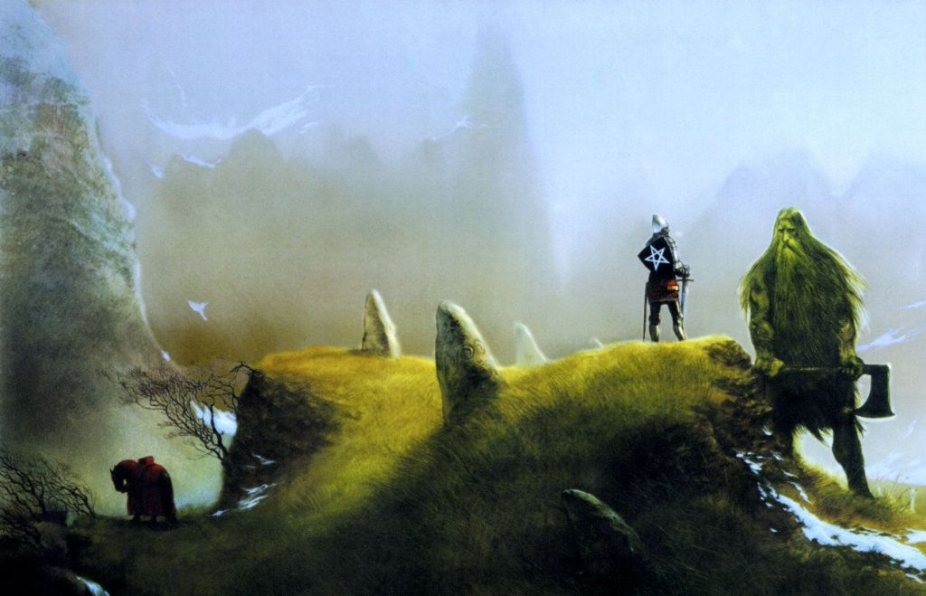
Gawain goes out into the wilderness to face the Green Knight as he has honorably promised. He prides himself on being the perfect Christian knight.

Slide 15
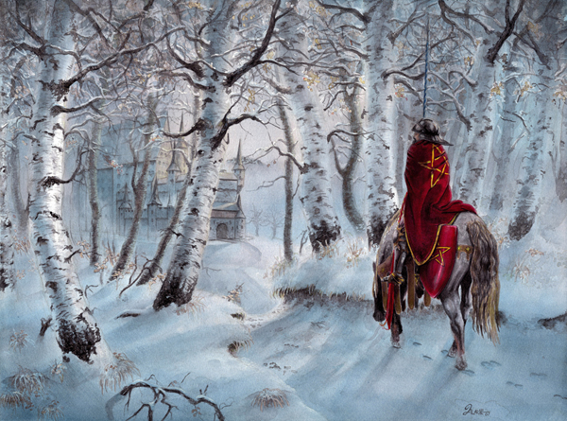
But here is the problem facing the Christian knights: how can one emulate Christ and be a soldier living in the real world?
Is it possible to be like Christ? Have the knights set themselves a goal they will never achieve?

Slide 16
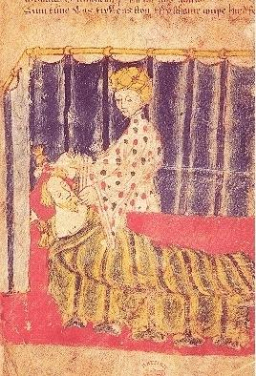
Faced with magic, and a lady who tempts him, Gawain stumbles as a perfect knight. He takes the story of his humiliation back to the court so that they all might learn from his mistakes.
He serves his king and helps develop new values for his civilization.

Slide 17
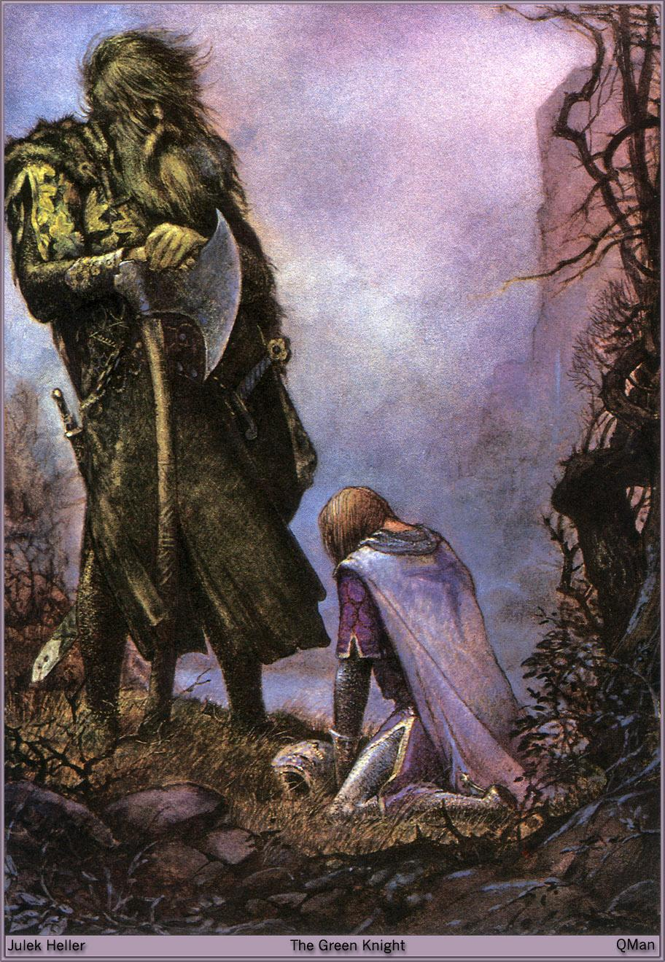
Green Knight as Fertility God
The Green Knight represents the life force in nature and in human beings.
The life force is what makes human beings try so hard to survive and what makes human beings reproduce.
Look at his color, his clothes and his wearing of the holly.

Slide 18
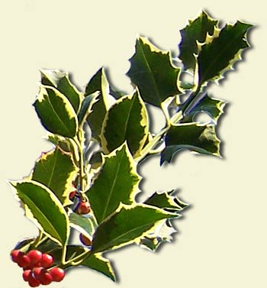
A Christian Poem
This poem is truly Christian, not the unformed Christianity of Beowulf.
The season for the story's setting is Christmas, the biggest ritual in the Christian world.
Of course, the Bible does not give us Jesus' birthday.

Slide 19
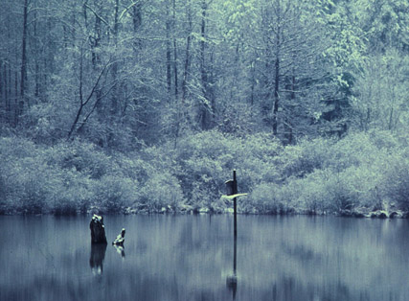
The early Christian Church, trying to make Christianity an easy to follow religion, chose Dec. 25 for Christmas. The pagan people (fertility-worshipping) were used to having a major celebration about this time around the Winter Solstice (Dec. 22, the shortest day of the year).

Slide 20
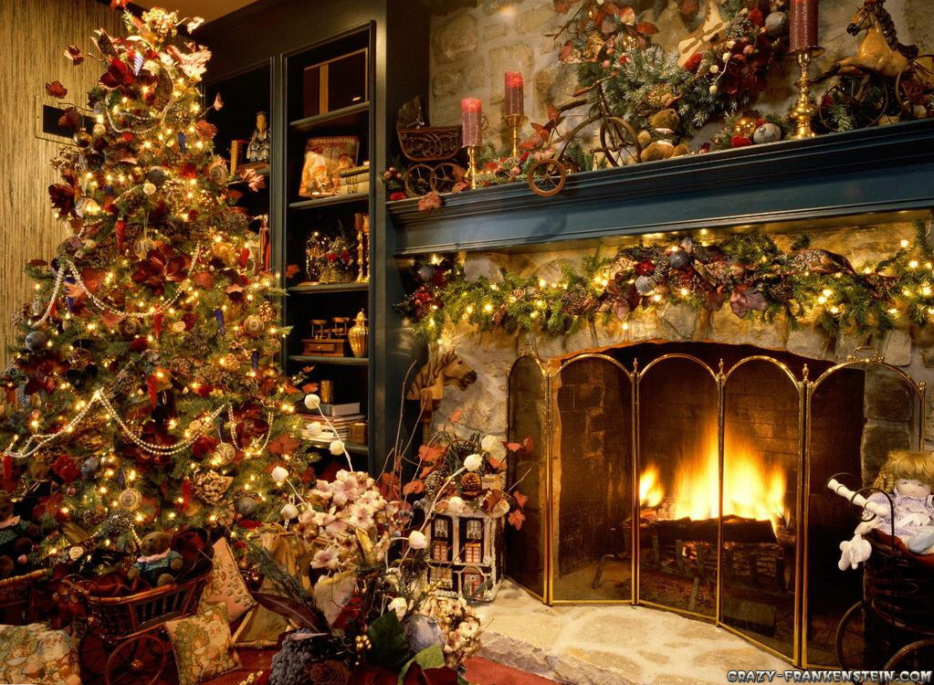
The early Church fathers more or less said, “You can still have your winter holiday, but we're going to call it Christmas, the celebration of the birth of your new god, Jesus.”

Slide 21
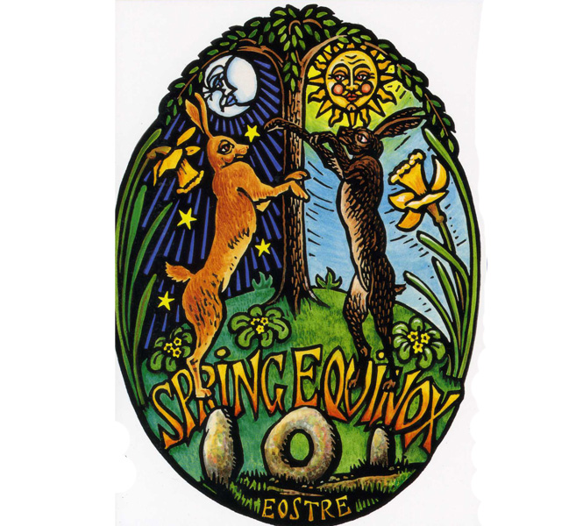
The same thing happened at Easter. The celebration of the Spring Equinox became the celebration of the Resurrection

Slide 22
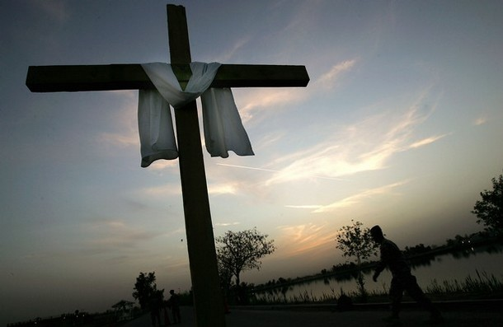
This superimposing the new religion on the old is one of the reasons for the success of Christianity in Europe.

Slide 23
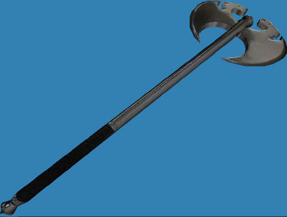
The Beheading Game
The Beheading Game occurs in earlier eighth and ninth century Irish (Celtic) romances.
In this poem, the Green Knight invites Gawain to exchange blows, not to chop off his head.
Watch how Gawain is tempted by anger.
He's insulted because the Green Knight belittles the valor of Arthur's court.

Slide 24
Guiding questions
Is Gawain good, bad or a little of both?
How do we judge him?
Does Gawain represent the best or the worst of human possibilities?
** These answers will help you develop your final exam essay!

