Slide 1
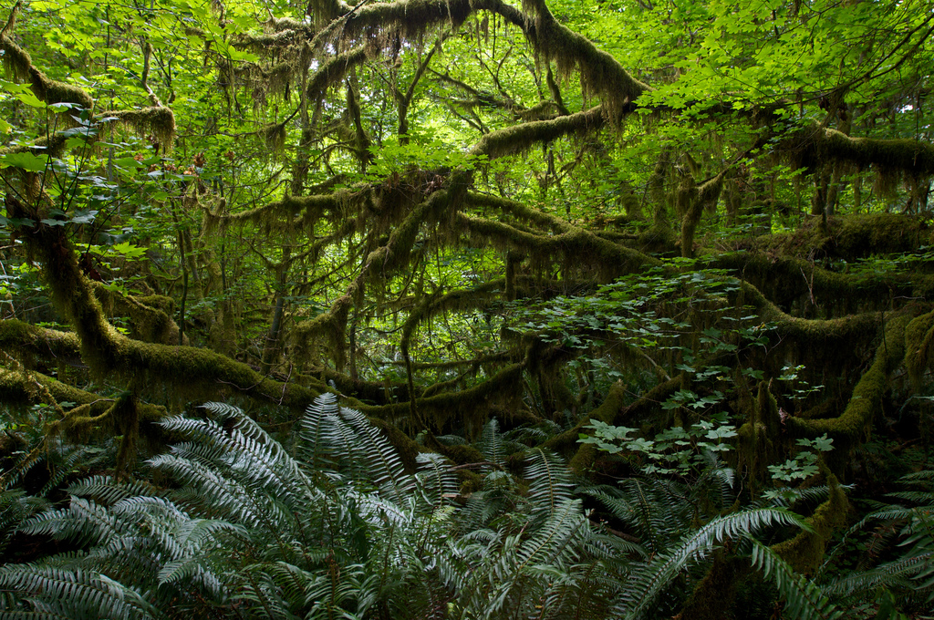
THURSDAY, NOVEMBER 12, 2015
Scrolling text repeating until end of slide

Slide 2
RAIDER REV
CONTINUE TO WORK ON UNIT NINE FROM THE WORKBOOK

Slide 3
“THE MOST DANGEROUS GAME” by RICHARD CONNELL

Slide 4
“THE MOST DANGEROUS GAME”
PREPARE TO READ PG 16
WHAT IS SUSPENSE?
USING CONTEXT CLUES

Slide 5
ESSENTIAL QUESTION:
WHO ARE/WERE THE COSSACKS?

Slide 6
TODAY’S READING AND DISCUSSION:
PAGES 19-?

Slide 7
CLOSING:
SUMMARY OR READING
REMINDER OF VOCAB QUIZ

