Slide 1
THURSADY, FEBRUARY 11, 2016
CISM WEEK

Slide 2
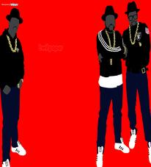
RAIDER REV 2-11-16
WHAT OTHER GENRES OF MUSIC DO YOU LISTEN TO BESIDES RAP?

Slide 3
TITLE” “RAP LYRICS ON TRIAL”

Slide 4
CISM FOCUS TODAY:
DIRECTED NOTE-TAKING

Slide 5
CLOSING

