Slide 1
Tuesday, FEBRUARY 9, 2016
CISM WEEK

Slide 2
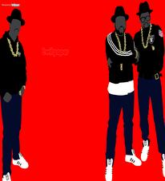
RAIDER REV 2-8-16
What is your favorite rap song and why??

Slide 3
SELF DESTRUCTION

Slide 4
TITLE” “RAP LYRICS ON TRIAL”

Slide 5
CLOSING

