Slide 1
WEDNESDAY, FEBRUARY 10, 2016
CISM WEEK

Slide 2
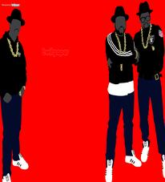
RAIDER REV 2-10-16
WHAT IS YOUR FAVORITE GENRE (TYPE) OF RAP MUSIC AND WHY?

Slide 3
TITLE” “RAP LYRICS ON TRIAL”

Slide 4
CISM FOCUS TODAY:
DIRECTED NOTE-TAKING

Slide 5
CLOSING

